Slide 1
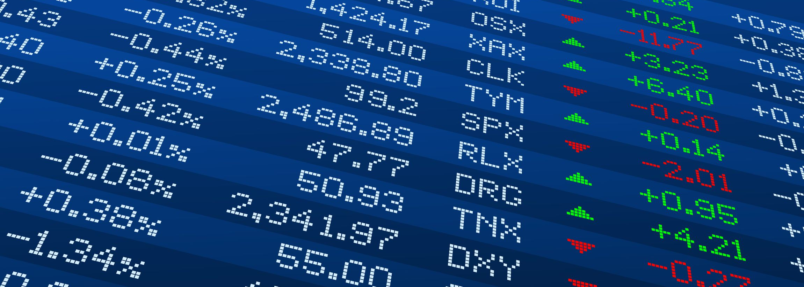
A System for Predicting Stock Price and Offering Financial Advice
Member List:​
HO, Chung Shun
TSE, Chun Lok
SHI, Jianhua
LING, Hou Lam
(Alan)
(Gordon)
(Simon)
(Howard) ​
DL2
Supervised by Prof. Dik-Lun LEE​

Slide 2
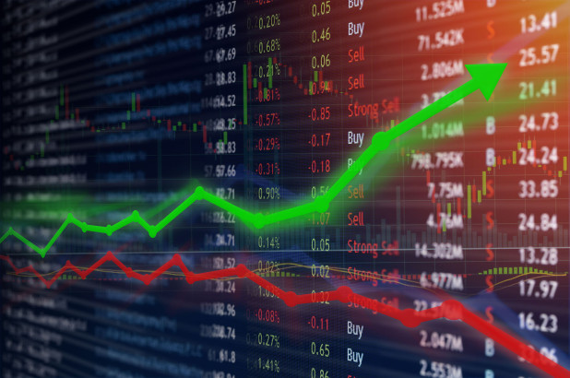

Introduction
Unknown factors are affecting the stock market
Strategies have been used to mitigate the risk
Utilizing these strategies requires advanced financial knowledge
Stock Market
People with no Financial Background

Slide 3


Objectives
Collect stock price and news data automatically and regularly​
Create machine learning models to predict the upcoming price​
Visualize predictions, provide portfolio recommendations and alerts ​

Slide 4

Project Scope – Stock Market
US Market
Of total world equity market value in 2020
11
Sectors
3,671
&
Stocks
156
Sub-industries
Total market capital
Number of stocks
Diversity of stocks

Slide 5


Project Scope – Stock
S&P 500
High Market Capital:
Not easy to be manipulated by some holding companies
Of overall market
capital in US stock market
High Popularity:
Able to find more news for analysis

Slide 6

Project Scope – Investment Goal
FIRE
Not Retired
Average Market Growth:
13.6%
(Average Annual Growth of S&P 500 in 2010-2019)
Expected Annual Growth
Retired
25x Rule:
Asset > 25 x Annual Expense
= Retirement
4% + Inflation

Slide 7



Overview
Stock Price Preprocessing
Web Application
Visualizing data
Data
Crawlers
Prediction
Models
Risk
Evaluation
Portfolio Recommendation
News
Analysis
Mobile Application
Receiving alerts
Collecting stock and news data
Using FinBERT to output sentiment score of news
Using Bi-LSTM to predict stock price
Evaluating risk of a stock
Generating user-tailored portfolios

Slide 8
Key Components
News
Analysis
Prediction
Models
Risk
Evaluation
Portfolio Recommendation

Slide 9
News Analysis

Slide 10
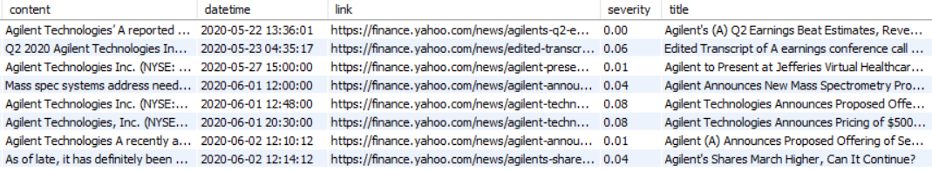
Stock News Collection
Historical news: collect from Google News with different computers & IP addresses
Real-time news: collect from stock page of Finviz
News data is first stored as json files, then imported to our database
News data period ranges from 01-01-2013 to present

Slide 11
Stock News Preprocessing
Filter out news that without exact posting date
Filter out unrelated news collected from Google News that has few or even no relevant stock keywords
Generate sentiment scores using sentiment analysis

Slide 12
Sentiment Analysis
Pre-trained FinBERT model is used
Significantly outperforms dictionary-based analysis (Loughran and McDonald dictionary)
Content of stock news is inputted to the model
Sentiment scores range from –1 to 1 are generated

Slide 13
Prediction Model

Slide 14
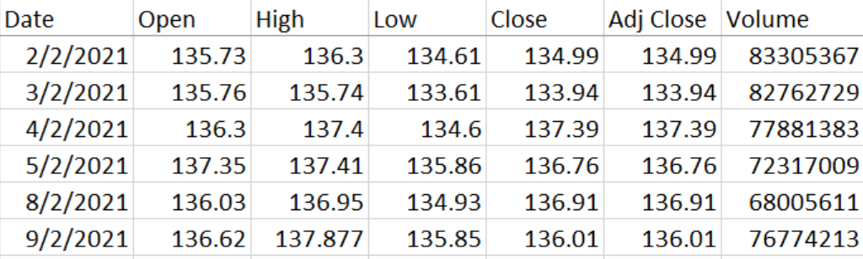
Stock Price Collection
Collect stock price after every trading day using yFinance API
Data stored as a DataFrame in csv format
Daily data is collected
Data period ranges from
01-01-2011 to present
Data Sample

Slide 15
Stock Price Preprocessing
Fill in any missing values
Generate Technical Indicators
Provide domain specific knowledge to gain better understanding
Commonly used by investors and financial analysts to determine the state of a stock
Reflects the trend, momentum, volatility and volume of a stock
Example such as SMA, EMA, MACD, RSI

Slide 16
Input to Prediction Model
Stock Prices, Technical Indicators and news sentiment scores are concatenated together
Stock Price: 5 columns
Technical Indicator: 21 columns
News Sentiment: 1 column

Slide 17





Input to Prediction Model
5 features
1. S&P500 Stock Data
From Stock Price Crawler
Generate
21 features
Input
2. Technical Indicator
Bidirectional LSTM
Sentiment
Analysis
1 feature
Yahoo Finance
News Data
From News Crawler
3. Sentiment Score

Slide 18
Stock Price Prediction Models
Predict the upcoming 90 days of stock price based on a fixed window size
Multiple machine learning architectures and optimal configuration of input features are tested and evaluated

Slide 19
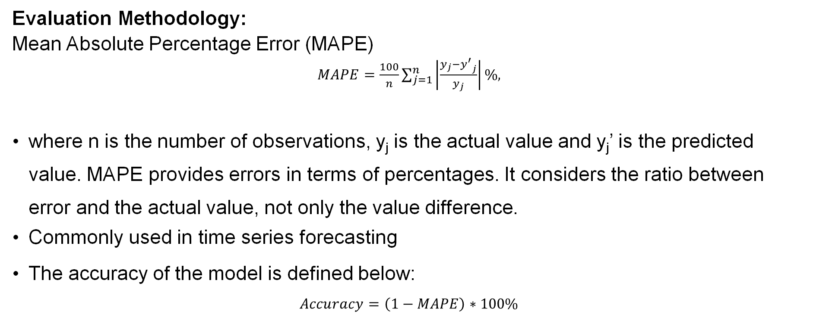
Stock Price Prediction Models
Evaluation Methodology:
Mean Absolute Percentage Error (MAPE)
$MAPE=\frac{100}{n}\sum_{j=1}^{n}{\left|\frac{y_{j}−{y^{′}}_{j}}{y_{j}}\right|\%}$,
where n is the number of observations, y_{j} is the actual value and y_{j}’ is the predicted value. MAPE provides errors in terms of percentages. It considers the ratio between error and the actual value, not only the value difference.
Commonly used in time series forecasting
The accuracy of the model is defined below:
$$Accuracy=\left(1−MAPE\right)∗100\%$$

Slide 20
Stock Price Prediction Models
Normalize the features using MinMaxScaler in Scikit Learn
Using Linear Activation for the output

Slide 21
Experiment 1
Find out optimal model architectures and hyperparameters using Grid Search
RNN, UNI-LSTM, BI-LSTM, GRU models have been tested with the following hyperparameters
Hyperparameters | Configurations
Number of Hidden Units | [32, 64, 128]
Number of Layers | [1, 2, 3, 4]
Dropout rate | [0.1, 0.2, 0.4, 0.5]
Learning rate | [0.005, 0.01, 0.02, 0.05]
Window size | [90, 180, 360]

Slide 22
Experiment 1
Bidirectional LSTM achieved the lowest validation loss
Optimal hyperparameters are listed below
Model | Validation Loss
RNN | 0.124
GRU | 0.153
Unidirectional LSTM | 0.122
Bidirectional LSTM | 0.111
Hyperparameters | Configuration
Number of Hidden Units | 32
Number of Layers | 2
Dropout rate | 0.5
Learning rate | 0.01
Window size | 90

Slide 23

Experiment 2
Different models are used to test the effect of using stock price, technical indicators and sentiment scores
 |  | Validation Loss
 |  | Model 1 | Model 2 | Model 3 | Model 4
Model Input | Stock Price
 | Sentiment Score
 | Technical Indicator
 |  | 0.251 | 0.258 | 0.217 | 0.199

Slide 24
Results
The Prediction models are trained after the experiments
Our final models averaged 86.39% accuracy

Slide 25
Risk Evaluation

Slide 26




Certainty Equivalent (CE)
Usage: To quantify people’s attitudes or preferences over risk and return
$$Certainty Equivalent \left(CE\right) =ER − 1/2 × \left(1−A\right) × 4 × RI^{2}$$
With a higher CE, the stock is relatively profitable at the same level of risk

Slide 27
Risk Evaluation
Why?
Minimizing the prediction error
As a reference for user
How?
Using stop points
-> Controlling the risk in acceptable range
Risk management
-> Quantify the risk to make investment decision

Slide 28
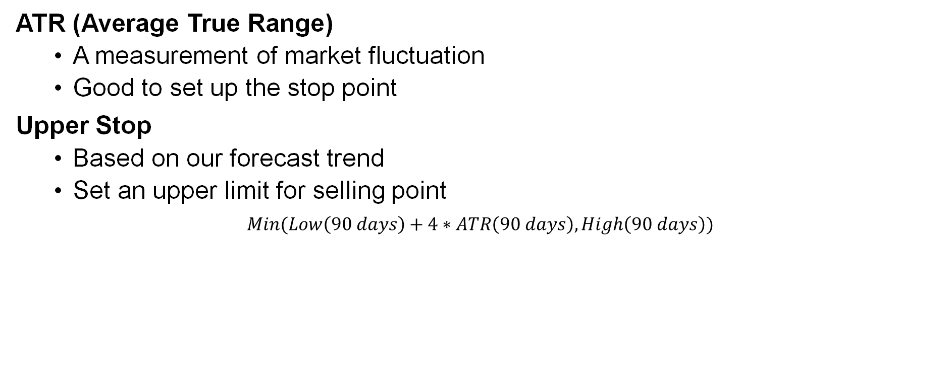
Stop Points - Upper Stop & Down Stop
ATR (Average True Range)
A measurement of market fluctuation
Good to set up the stop point
Upper Stop
Based on our forecast trend
Set an upper limit for selling point
$$Min(Low\left(90 days\right)+4∗ATR\left(90 days\right),High\left(90 days\right))$$

Slide 29
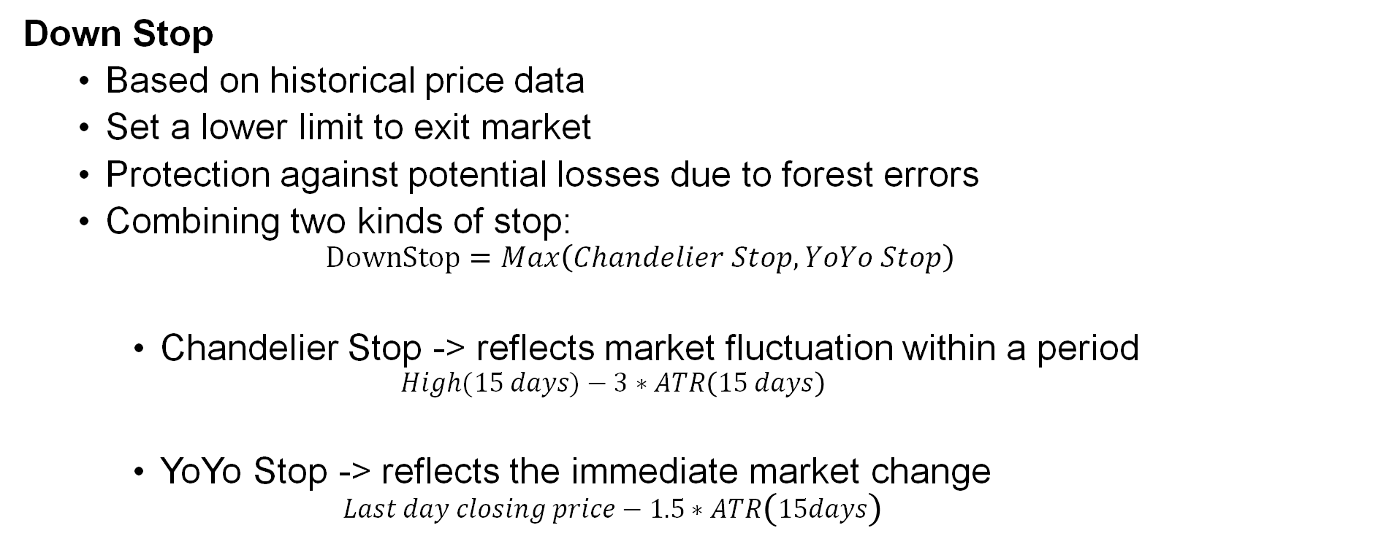
Stop Points - Upper Stop & Down Stop
Down Stop
Based on historical price data
Set a lower limit to exit market
Protection against potential losses due to forest errors
Combining two kinds of stop:
$$DownStop=Max\left(Chandelier Stop,YoYo Stop\right)$$
Chandelier Stop -> reflects market fluctuation within a period
$$High(15 days)−3∗ATR\left(15 days\right)$$
YoYo Stop -> reflects the immediate market change
$$Last day closing price−1.5∗ATR\left(15days\right)$$

Slide 30
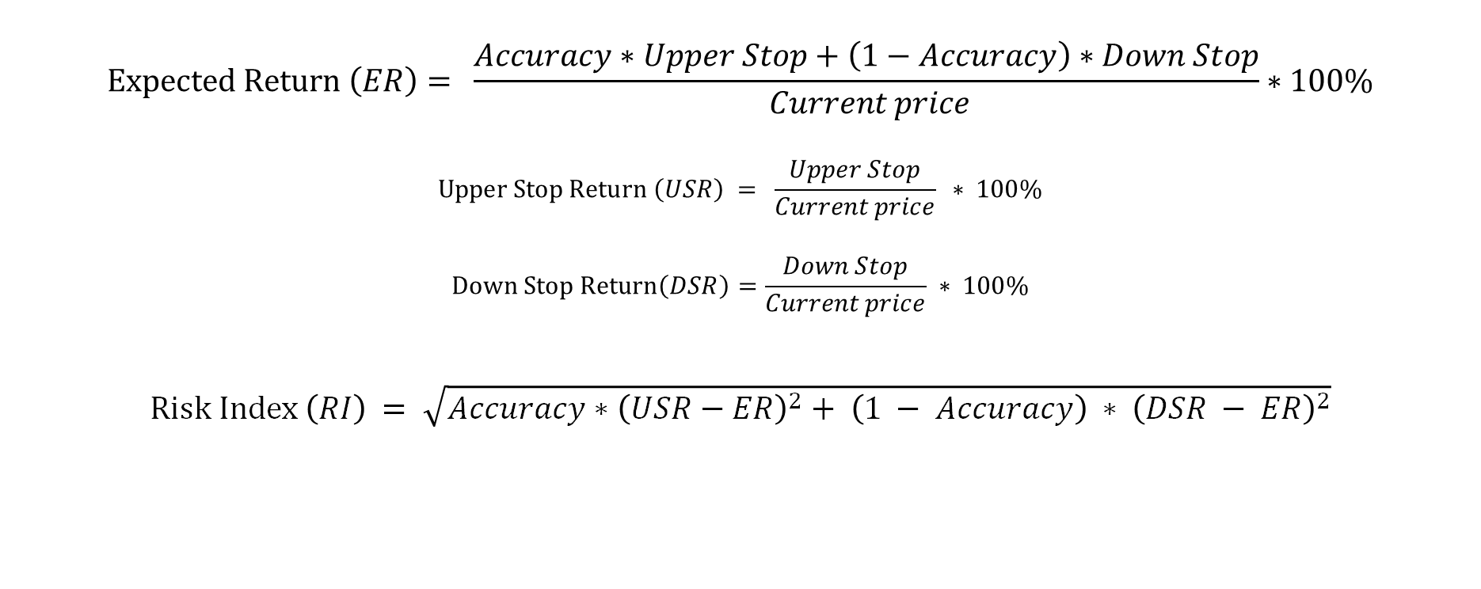
Stock Risk Index
$$Expected Return \left(ER\right)= \frac{Accuracy∗Upper Stop+\left(1−Accuracy\right)∗Down Stop}{ Current price}∗100\%$$
$$Upper Stop Return \left(USR\right) = \frac{Upper Stop}{Current price} ∗ 100\%$$
$$Down Stop Return\left(DSR\right)=\frac{Down Stop}{Current price} ∗ 100\%$$
$$Risk Index \left(RI\right) = \sqrt{Accuracy∗{\left(USR−ER\right)}^{2}+ \left(1 − Accuracy\right) ∗ {\left(DSR − ER\right)}^{2}}$$

Slide 31
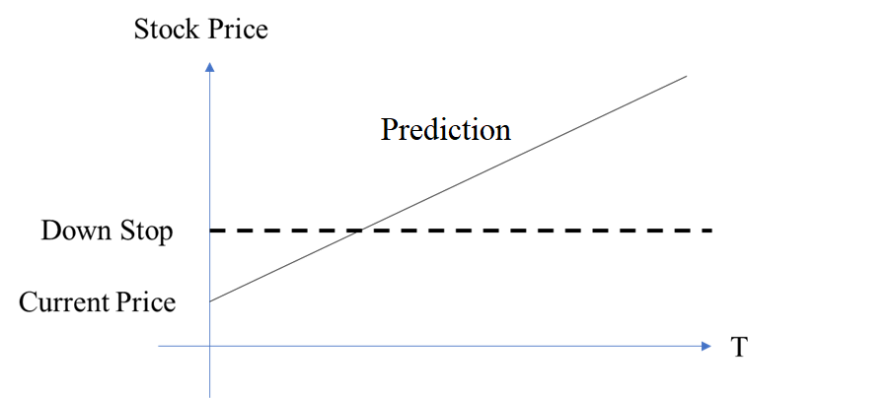
Screening
Filter unrecommended stock
Case 1:
Prediction trend is rising but historical trend drop beyond down stop

Slide 32
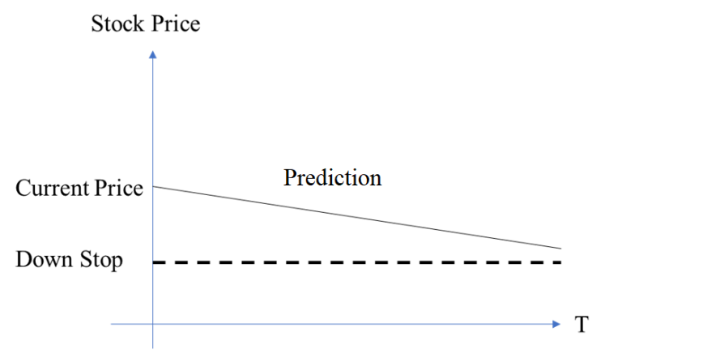
Screening
Filter unrecommended stock
Case 2:
Bearish trend

Slide 33
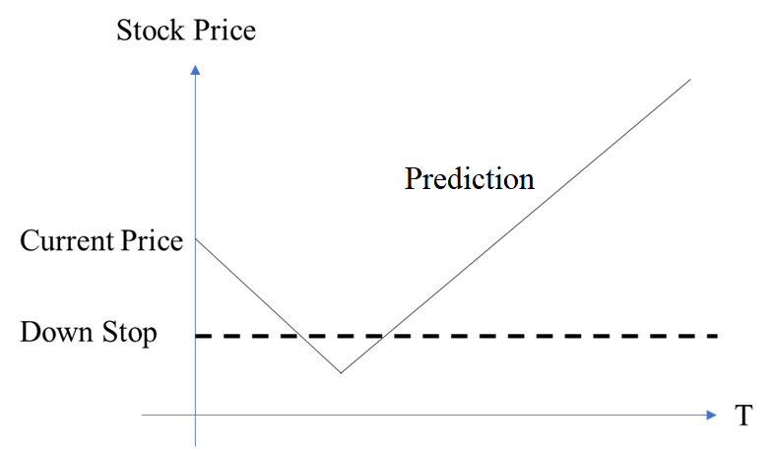
Screening
Filter unrecommended stock
Case 3:
Break through Down Stop

Slide 34
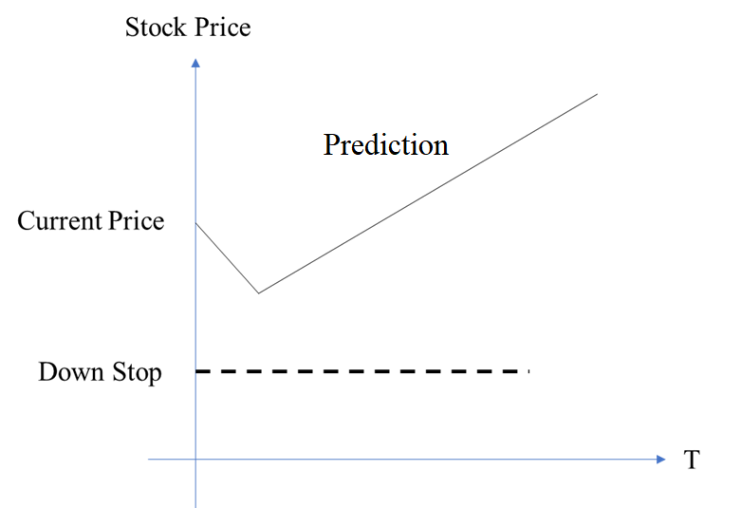
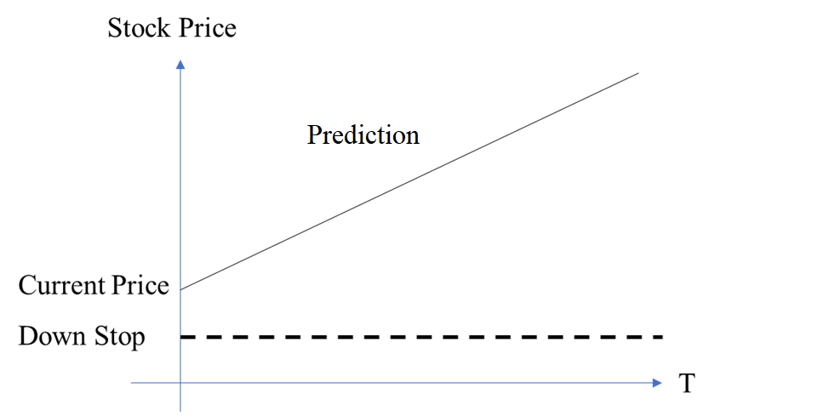
Screening
2 recommended cases:
Bullish trend

Slide 35
Portfolio Recommendation

Slide 36
Portfolio Recommendation
User Info Analysis
Stock Classification
Portfolio
Output
Input
User Financial Info
Risk Index
Expected Return
User Acceptable Risk Index
Maximize Profit
Aggressive
Stock
Aggressive
Portfolio
Balance Risk
Certainty Equivalent
(CE)
Minimize Risk
Defensive
Stock
Defensive
Portfolio

Slide 37
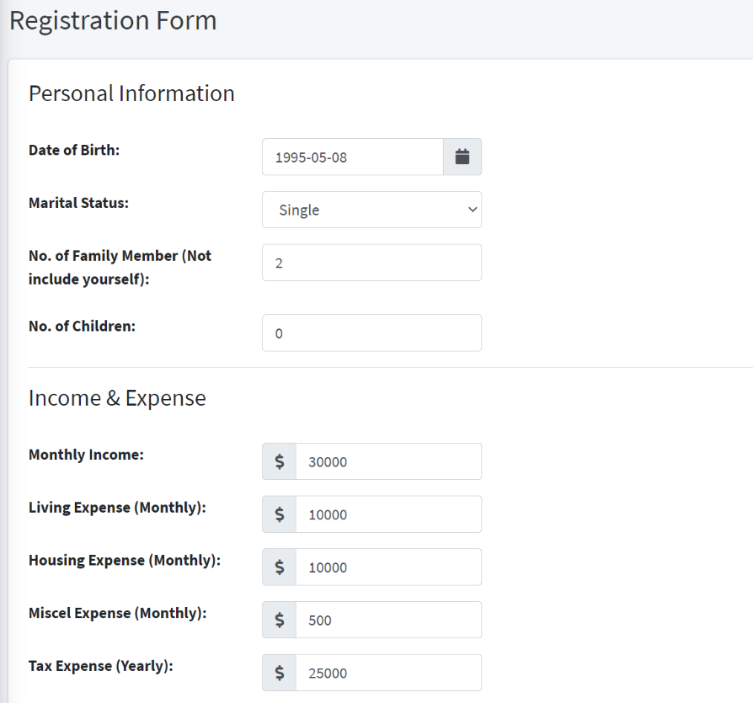
User Info Analysis – Data Collection
Collect user financial info through web application
Raw Data (Dollar unit: USD)
Monthly Income (Monthly)
Living Expense (Monthly)
Housing Expense (Monthly)
Miscel Expense (Monthly)
Tax Expense (Yearly)
Equity
Debt

Slide 38
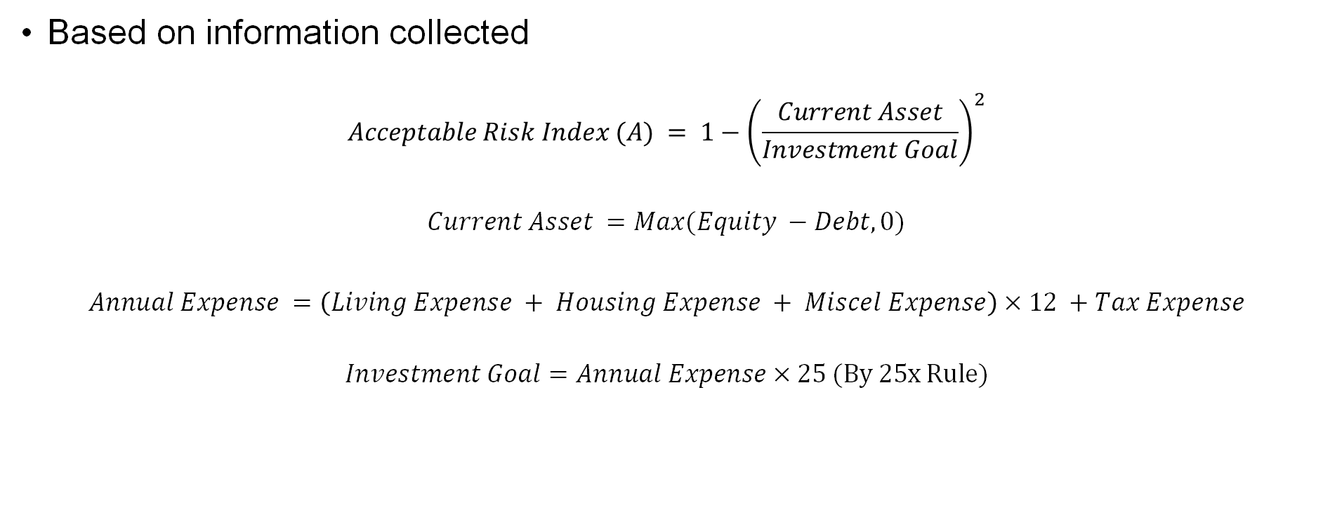
User Info Analysis – User Acceptable Risk Index
Based on information collected
$$Acceptable Risk Index (A) = {1−\left(\frac{Current Asset}{Investment Goal}\right)}^{2}$$
$$Current Asset =Max(Equity −Debt,0)$$
$$Annual Expense =\left(Living Expense + Housing Expense + Miscel Expense\right)×12 +Tax Expense$$
$$Investment Goal=Annual Expense×25 (By 25x Rule)$$

Slide 39
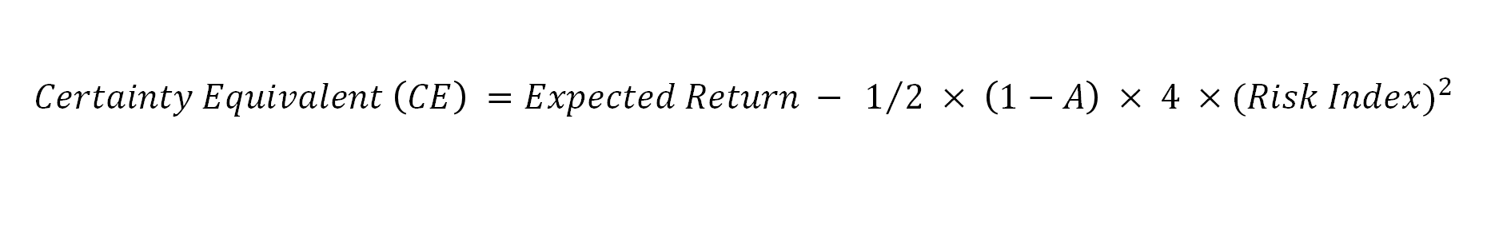

Stock Classification
$$Certainty Equivalent \left(CE\right) =Expected Return − 1/2 × \left(1−A\right) × 4 ×(Risk {Index)}^{2}$$
$A$ : User Acceptable Risk Index
With a higher $CE$, the stock is relatively profitable at the same level of risk
 | Aggressive Stock | Defensive Stock
Target Investors | Users not yet retired | Retired users
Positioning | Maximum profit | Minimum risk
Expected Annual CE | 13.6% (average S&P 500 growth) | 4% (4% rule) +1.40% (inflation) = 5.40%

Slide 40
Stock Classification
Aggressive Stock:
10 aggressive stocks with the highest expected return → Aggressive stock pool
Defensive Stock:
10 defensive stocks with the lowest risk index → Defensive stock pool

Slide 41
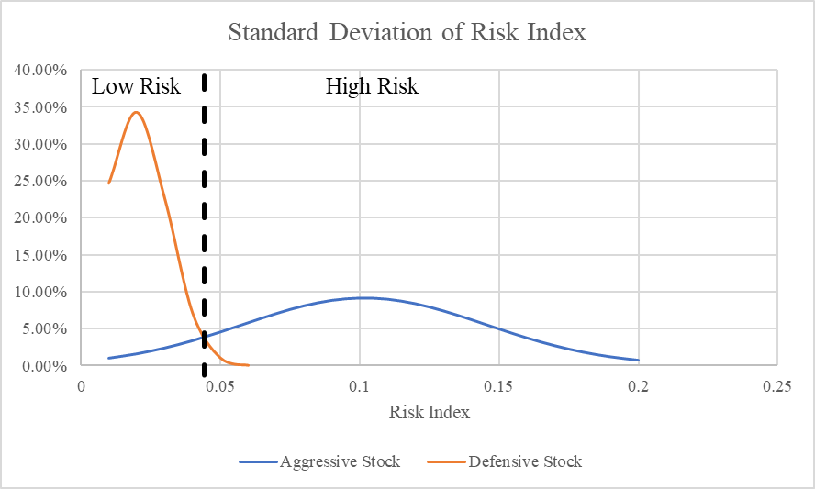
Stock Type Distribution
Maximum Risk Index for Defensive Stock = 0.043

Slide 42
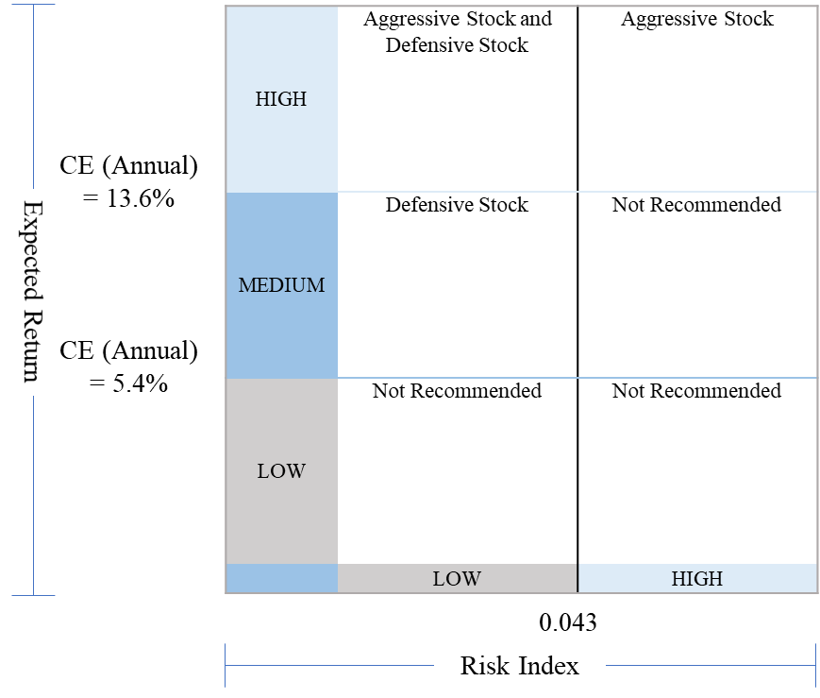
Stock Matrix

Slide 43
Aggressive Portfolio
User Status: Not Retired
Total Asset: $10,000
Investment Goal: $1,000,000
FIRE Progress: 1%
Portfolio:
5 Stocks
Each stock: 20% of the portfolio
100%
5
Stocks

Slide 44
Aggressive Portfolio
User Status: Not Retired
Total Asset: $700,000
Investment Goal: $1,000,000
FIRE Progress: 70%
Portfolio:
10 Stocks
Each pair of aggressive stock and defensive stock: 20% of the portfolio
50%
5
Stocks
50%
5
Stocks

Slide 45
Defensive Portfolio
User Status: Retired
Total Asset: $1,100,000
Investment Goal: $1,000,000
FIRE Progress: >100%
Portfolio:
10 Stocks
Each stock: 10% of the portfolio
100%
10
Stocks

Slide 46
Aggressive Portfolio Result
User Status: Not Retired
Total Asset: $10,000
Investment Goal: $1,000,000
FIRE Progress: 1%
Portfolio:
5 Stocks
Each stock: 20% of the portfolio
Expected Growth: 10.2%

Slide 47
Defensive Portfolio Result
User Status: Retired
Total Asset: $1,100,000
Investment Goal: $1,000,000
FIRE Progress: >100%
Portfolio:
10 Stocks
Each stock: 10% of the portfolio
Expected Growth: 4.05%

Slide 48


Experiment Conclusion
 | Aggressive Portfolio | Defensive Portfolio
Expected Annual Return | 13.60% | 5.40%
Annualized Return | 12.24% | 12.03%
Average Monthly Growth | 1.0% | 1.0%
Maximum Monthly Profit | 13.6% | 4.6%
Maximum Monthly Loss | -5.2% | -0.8%

Slide 49
Demonstration

Slide 50
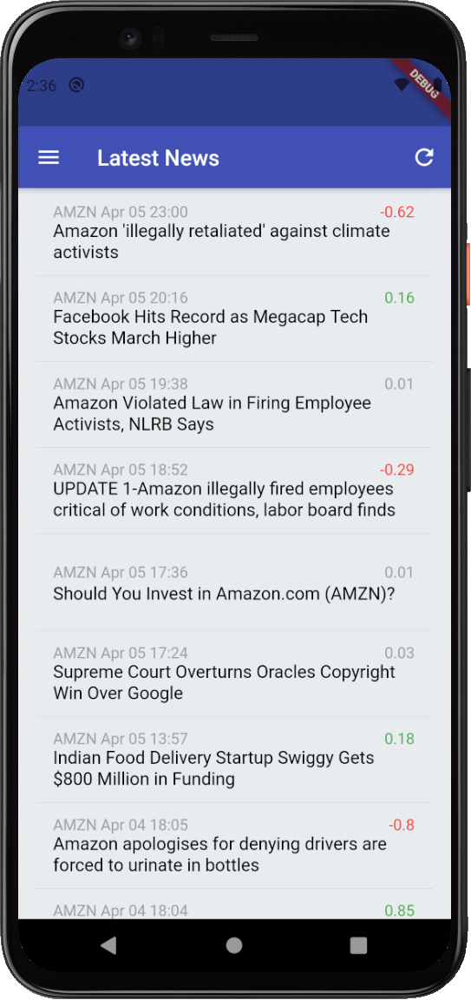
Demonstration
Display and notify latest news
Positive news (sentiment score > 0.1) are in Green
Negative news (sentiment score < -0.1) are in Red
Neutral news (-0.1< sentiment score < 0.1) are in Grey
Click on the tiles to open the website displaying the news

Slide 51
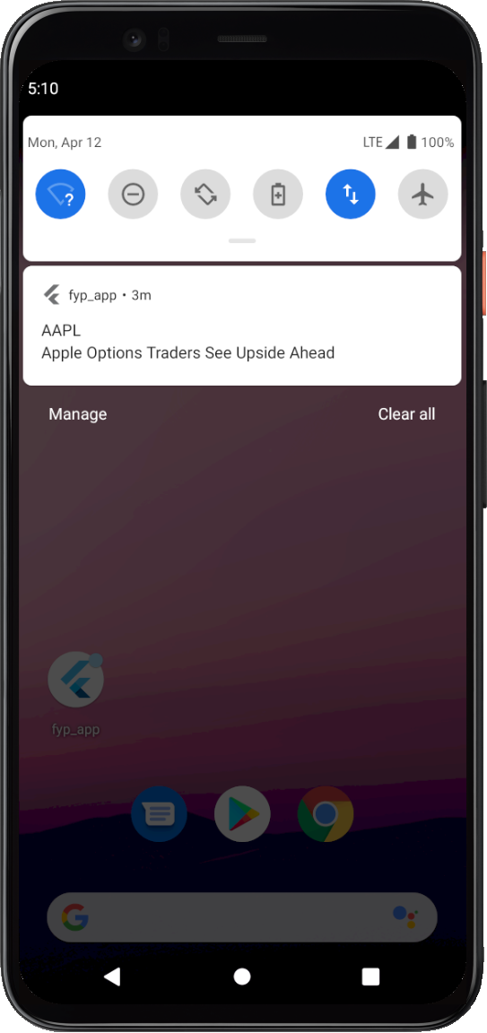
Demonstration
Receive notifications on stock news update when backend crawls a new piece of news article

Slide 52
Conclusion
Successfully collect stock price and news data regularly and automatically
Trained prediction models with reasonable accuracy
Carried out Risk Management to limit risks
Carried out Portfolio Management to recommend suitable portfolios
Visualized by a user-friendly Web application and Mobile Application

Slide 53
Limitations and Future Work
More factors can be incorporated into the system for stock price prediction
Limited information is embedded in sentiment score, event extraction can be applied and embeddings can be directly input to the stock price prediction model
Incorporate more functionalities in the web and mobile application

Slide 54

Q&A

